Slide 1


SQL Queries for Healthcare Data Analysis
This presentation explores SQL queries for analyzing healthcare data, focusing on tasks such as joining tables, handling null values, using aggregate functions, and identifying data mismatches. We'll also cover window functions, conditional expressions, numeric and string functions, subqueries, date and time functions, and complex joins for identifying top doctors.
by Mohammed Niyaz.M

Slide 2
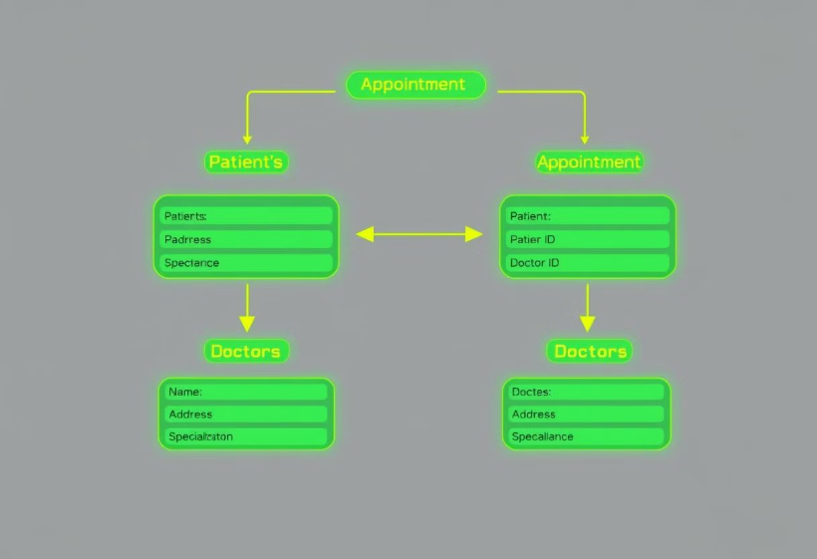
Inner and Equi Joins
Completed Appointments
Fetch details of completed appointments, including patient name, doctor name, and specialization.
SQL Query:
SELECT a.status, p.name AS patient_name, d.name AS doctor_name, d.specialization FROM appointments AS a JOIN patients AS p ON a.patient_id = p.patient_id JOIN doctors AS d ON a.patient_id = d.doctor_id WHERE status = 'completed';
This query joins the appointments, patients, and doctors tables to retrieve information about completed appointments. It links the tables using patient and doctor IDs and filters the results to show only completed appointments.

Slide 3

Left Join with Null Handling
Patients with No Appointments
Retrieve all patients who have never had an appointment, including their name, contact details, and address.
SQL Query
SELECT DISTINCT p.patient_id, p.name, p.contact_number, p.address, a.status FROM patients AS p LEFT JOIN appointments AS a ON p.patient_id = a.patient_id WHERE a.status = 'cancelled';
This query uses a left join to include all patients, even those without appointments. It then filters the results to show only patients where the appointment status is cancelled, effectively identifying patients who have never had an appointment.

Slide 4



Right Join and Aggregate Functions
Total Diagnoses
SQL Query
Find the total number of diagnoses for each doctor, including doctors who haven’t diagnosed any patients.
SELECT d.name AS doctor_name, d.specialization, COUNT(di.diagnosis_id) AS total_diagnoses FROM doctors AS d RIGHT JOIN diagnoses AS di ON d.doctor_id = di.patient_id GROUP BY d.doctor_id, d.name, d.specialization;
This query uses a right join to include all doctors, even those without diagnoses. It counts the number of diagnoses for each doctor and groups the results by doctor ID, name, and specialization.

Slide 5


Full Join for Overlapping Data
Mismatches
Identify mismatches between the appointments and diagnoses tables.
SQL Query
SELECT DISTINCT appointment_id, app_patient, app_doctor, status, diagnosis_id, diag_patient, diag_doctor, diagnosis FROM ( SELECT a.appointment_id, a.patient_id AS app_patient, a.doctor_id AS app_doctor, a.status, d.diagnosis_id, d.patient_id AS diag_patient, d.doctor_id AS diag_doctor, d.diagnosis FROM appointments AS a LEFT JOIN diagnoses AS d ON a.appointment_id = d.doctor_id UNION SELECT a.appointment_id, a.patient_id AS app_patient, a.doctor_id AS app_doctor, a.status, d.diagnosis_id, d.patient_id AS diag_patient, d.doctor_id AS diag_doctor, d.diagnosis FROM appointments AS a RIGHT JOIN diagnoses AS d ON a.appointment_id = d.doctor_id ) AS combined_results;
This query uses a full join (simulated with a UNION of left and right joins) to combine data from the appointments and diagnoses tables. It identifies mismatches by including all records from both tables, even when there is no corresponding record in the other table.

Slide 6


Window Functions (Ranking and Aggregation)
SQL Query
SELECT a.doctor_id, d.name AS doctor_name, a.patient_id, p.name AS patient_name, COUNT(a.appointment_id) AS total_appointments, RANK() OVER (PARTITION BY a.doctor_id ORDER BY COUNT(a.appointment_id) DESC) AS rank_position FROM appointments AS a JOIN doctors AS d ON a.doctor_id = d.doctor_id JOIN patients AS p ON a.patient_id = p.patient_id GROUP BY a.doctor_id, d.name, a.patient_id, p.name;
Patient Ranking
1
Rank each doctor's patients based on the number of appointments in descending order.
2
This query uses a window function (RANK()) to rank patients for each doctor based on the number of appointments. The PARTITION BY clause ensures that the ranking is done separately for each doctor.

Slide 7
Conditional Expressions
Age Groups
1
Categorize patients by age group (e.g., 18-30, 31-50, 51+). Count the number of patients in each age group.
SQL Query
SELECT CASE WHEN age BETWEEN 18 AND 30 THEN '18-30' WHEN age BETWEEN 31 AND 50 THEN '31-50' WHEN age > 50 THEN '51+' ELSE 'Unknown' END AS age_group, COUNT(*) AS total_patients FROM patients GROUP BY age_group ORDER BY age_group;
2
This query uses a CASE statement to categorize patients into age groups. It then counts the number of patients in each group and orders the results by age group.

Slide 8

Numeric and String Functions
UPPER
Patient Names
Retrieve a list of patients whose contact numbers end with "1234" and display their names in uppercase.
SQL
Query
SELECT UPPER(name) AS patient_name FROM patients WHERE contact_number LIKE '%1234';
This query uses the UPPER() function to display patient names in uppercase and the LIKE operator to filter patients whose contact numbers end with "1234".

Slide 9
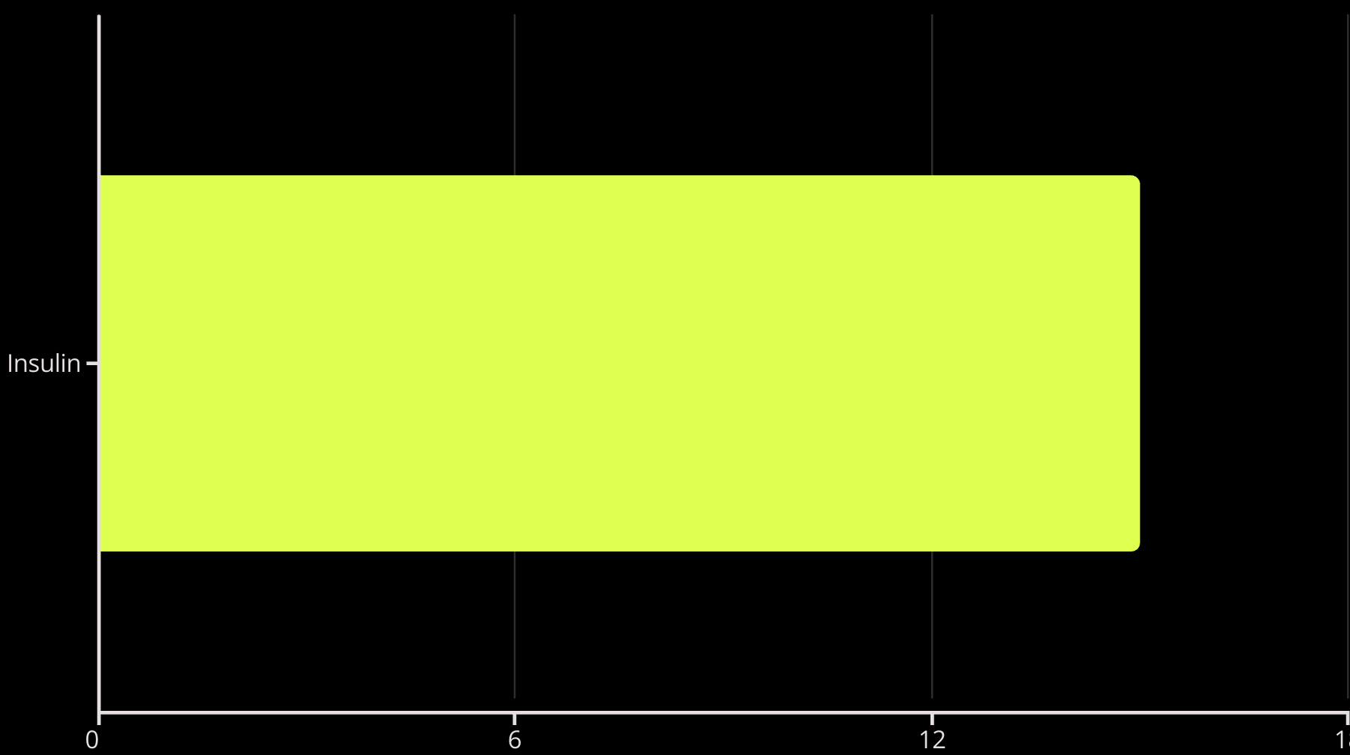
Subqueries for Filtering
Find patients who have only been prescribed "Insulin" in any of their diagnoses.
SELECT p.patient_id, p.name, m.medication_name FROM patients AS p JOIN diagnoses AS d ON p.patient_id = d.patient_id JOIN medications AS m ON d.patient_id = m.medication_id WHERE m.medication_name = 'Insulin';
This query retrieves patients who have been prescribed "Insulin".

Slide 10

Complex Joins and Aggregation
Top Doctor
Identify the doctor who has attended the most unique patients.
SELECT d.doctor_id, d.name AS doctor_name, d.specialization, COUNT(DISTINCT a.patient_id) AS unique_patients FROM doctors d JOIN appointments a ON d.doctor_id = a.doctor_id GROUP BY d.doctor_id, d.name, d.specialization ORDER BY unique_patients DESC LIMIT 1;
This query identifies the doctor with the most unique patients.
This query joins the doctors and appointments tables, counts the number of unique patients for each doctor, and orders the results to find the doctor with the highest count.

